Slide 1

cryptography
&
Network security

Slide 2


Henry
Stella

Slide 3
Let’s consider Henry and Stella who want to exchange messages securely using encrypted messages.
Henry
Stella

Slide 4
To be able to send encrypted messages, an encryption/decryption key must be formulated
Henry
Stella

Slide 5

Sending this key directly makes it easy for hackers to capture it in transit

Slide 6

Sending this key directly makes it easy for hackers to capture it in transit

Slide 7


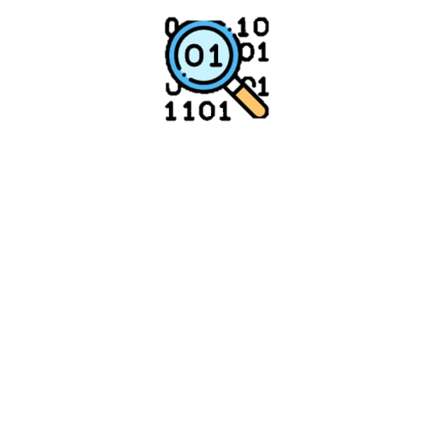






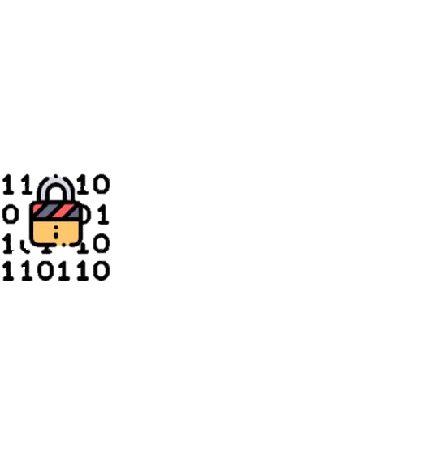
DIFFIE-HELLMAN
KEY EXCHANGE
ALGORITHM

Slide 8




ISITA JANA
Arpita Sarkar
MEET OUR TEAM
Suparna BISWAS
Sneha Khan

Slide 9
ISITA JANA
Arpita Sarkar
Enrollment No :
2112200001106
Registration no :
210011065261
Suparna BISWAS
Sneha Khan

Slide 10
ISITA JANA
Arpita Sarkar
Enrollment No :
2112200001098
Registration no :
210010986105
Suparna BISWAS
Sneha Khan

Slide 11
ISITA JANA
Arpita Sarkar
Enrollment No :
2112200001128
Registration no :
210011286906
Suparna BISWAS
Sneha Khan

Slide 12
ISITA JANA
Arpita Sarkar
Enrollment No :
2112200001125
Registration no :
210011257519
Suparna BISWAS
Sneha Khan

Slide 13
01
Introduction
02
Description & Flowchart
TABLE OF
CONTENTS
03
Example
04
Why the algorithm works?
05
Drawbacks
06
Application
07
Conclusion

Slide 14
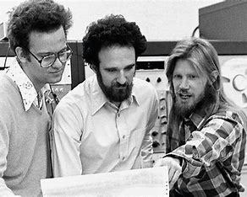
Introduction
Whitefield Diffie and Martin Hellman devised an amazing solution to the problem of key agreement, or key exchange in 1976. This solution is called
Diffie Hellman Key Exchange/Agreement Algorithm.
The beauty of the scheme is that two parties , who want to communicate securely, can agree on a symmetric key using this technique. This key can then be used for encryption/decryption.
Ralph Merkle, Martin Hellman, Whitfield Diffie

Slide 15
Diagrammatic representation of
the algorithm

Slide 16
1
Alice
Bob
Alice and Bob agree on two prime numbers, p and g.
2
4
A = g^x mod p
B = g^y mod p
3
5
A
B
6
7
K1 = B^x mod p
K2 = A^y mod p
As it turns out, K1 = K2 = K. K thus becomes the shared symmetric key between Alice and Bob.

Slide 17
DESCRIPTION
OF
THE
ALGORITHM

Slide 18
DESCRIPTION OF THE ALGORITHM
Let us assume that Alice and Bob want to agree upon a key to be used for encrypting/decrypting messages that would be exchanged between them. Then, the Diffie-Hellman key exchange algorithm works as shown below:
Firstly, Alice and Bob agree on two large prime numbers, p and g. These two integers need not be kept secret. Alice and Bob can use an insecure channel to agree on them.
Alice chooses another large random number x, and calculates A such that:
A = g^x mod p
Alice sends the number A to Bob.
Bob independently chooses another large random integer y and calculates B such that:
B = g^y mod p
Bob sends the number B to Alice.
A now computes the secret key K1 as follows:
K1 = B^x mod p
B now computes the secret key K2 as follows:
K2 = A^y mod p

Slide 19
EXAMPLE

Slide 20
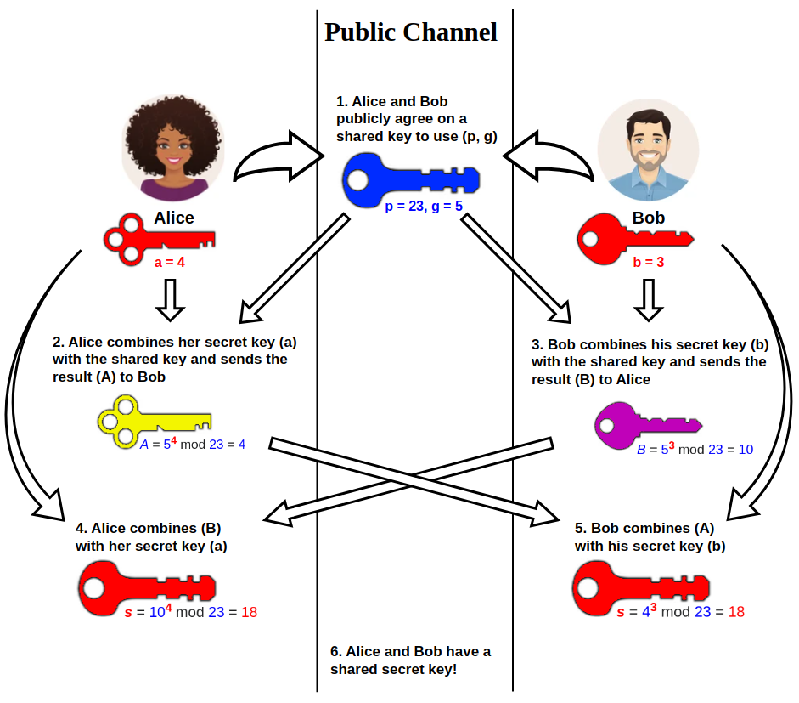
EXAMPLE

Slide 21
Why Diffie-Hellman works?

Slide 22
Why Diffie-Hellman works?
Alice
Bob
Alice fills up another one-third of the key using her secret random number
g
One-third of the key (g) is public
g
Bob fills up another one-third of the key using his secret random number
x
Alice sends the key to Bob
Bob sends the key to Alice
y
g
g
x
y
Alice completes the key by adding the last part received from Bob
Bob completes the key by adding the last part received from Alice
y
x
g
g
Both keys are the same because the order of completion (x first or y first) does not matter

Slide 23
LIMITATIONS OF THE ALGORITHM
Lack of authentication procedure.
Algorithm can be used only for symmetric key exchange.
As there is no authentication involved, it is vulnerable to man-in-the-middle attack.
As it is computationally intensive, it is expensive in terms of resources and CPU performance time.
Encryption of information cannot be performed with the help of this algorithm.
Digital signature cannot be signed using Diffie-Hellman algorithm.

Slide 24
Applications of Diffie-Hellman KEY EXCHANGE Algorithm
Diffie-Hellman is currently used in many protocols, namely:
- Secure Sockets Layer(SSL)/Transport Layer Secure(TLS)
- Secure Shell(SSH)
- Internet Protocol Security (IPsec)
- Public Key Infrastructure(PKI)
- Internet Key Exchange(IKE)

Slide 25


conclusion
The Diffie-Hellman Key Exchange Algorithm is a secure way of keys exchange across a public channel.
The DH key exchange method allows the two parties that have zero knowledge of each other to set up a shared secret over an insecure (public)channel.
For exchanging data in secret communication across a public channel domain , Diffie-Hellman key exchange establishes a shared secret between the two parties.
Diffie-Hellman is used in creating a variety of Internet services.
DH key agreement is a non-authentication key-agreement protocol , it forms the foundation for many authenticated protocols and is used in transport layer Security’s ephemeral modes to provide forward secrecy.

Slide 26
conclusion
The Diffie-Hellman Key Exchange Algorithm is a secure way of keys exchange across a public channel.
The DH key exchange method allows the two parties that have zero knowledge of each other to set up a shared secret over an insecure (public) channel.
For exchanging data in secret communication across a public channel domain , Diffie-Hellman key exchange establishes a shared secret between the two parties.
Diffie-Hellman is used in creating a variety of Internet services.
DH key agreement is a non-authentication key-agreement protocol , it forms the foundation for many authenticated protocols and is used in transport layer Security’s ephemeral modes to provide forward secrecy.

Slide 27

Acknowledgement
As we have come to the end of our presentation I would like to thank Rana Sir for giving us this opportunity to perform, thanks to all the lovely audience for patiently hearing us out and bearing with our mistakes , last but not the least I would like to thank my team members Isita ,Arpita and Suparna for their constant support and cooperation .
So, we would like to sign off by saying ,
"Encrypt your data and protect your future."

Slide 28
THANK
YOU

